Slide 2
職場故事
緊急
WARNING

Slide 3
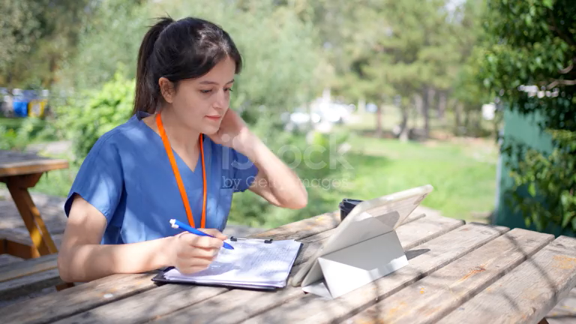
1.目標
ATTENTION
Notes:
https://www.istockphoto.com/video/female-intern-sitting-at-a-bench-in-the-garden-doing-paperwork-gm1717629831-540433070?utm_source=pixabay&utm_medium=affiliate&utm_campaign=SRP_video_sponsored&utm_content=https%3A%2F%2Fpixabay.com%2Fvideos%2Fsearch%2Fintern%2F%3Forder%3Dec&utm_term=intern

Slide 4

2.阻礙
ATTENTION
Notes:
https://unsplash.com/photos/a-group-of-people-sitting-at-a-table-with-notebooks-and-pens-YyzzcE13TKQ

Slide 5
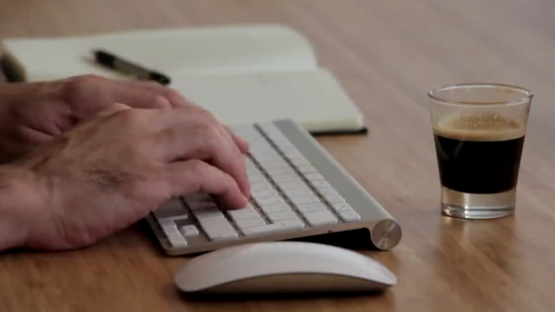
3.努力
ATTENTION
Notes:
https://pixabay.com/videos/keyboard-hands-writing-computer-1046/

Slide 6
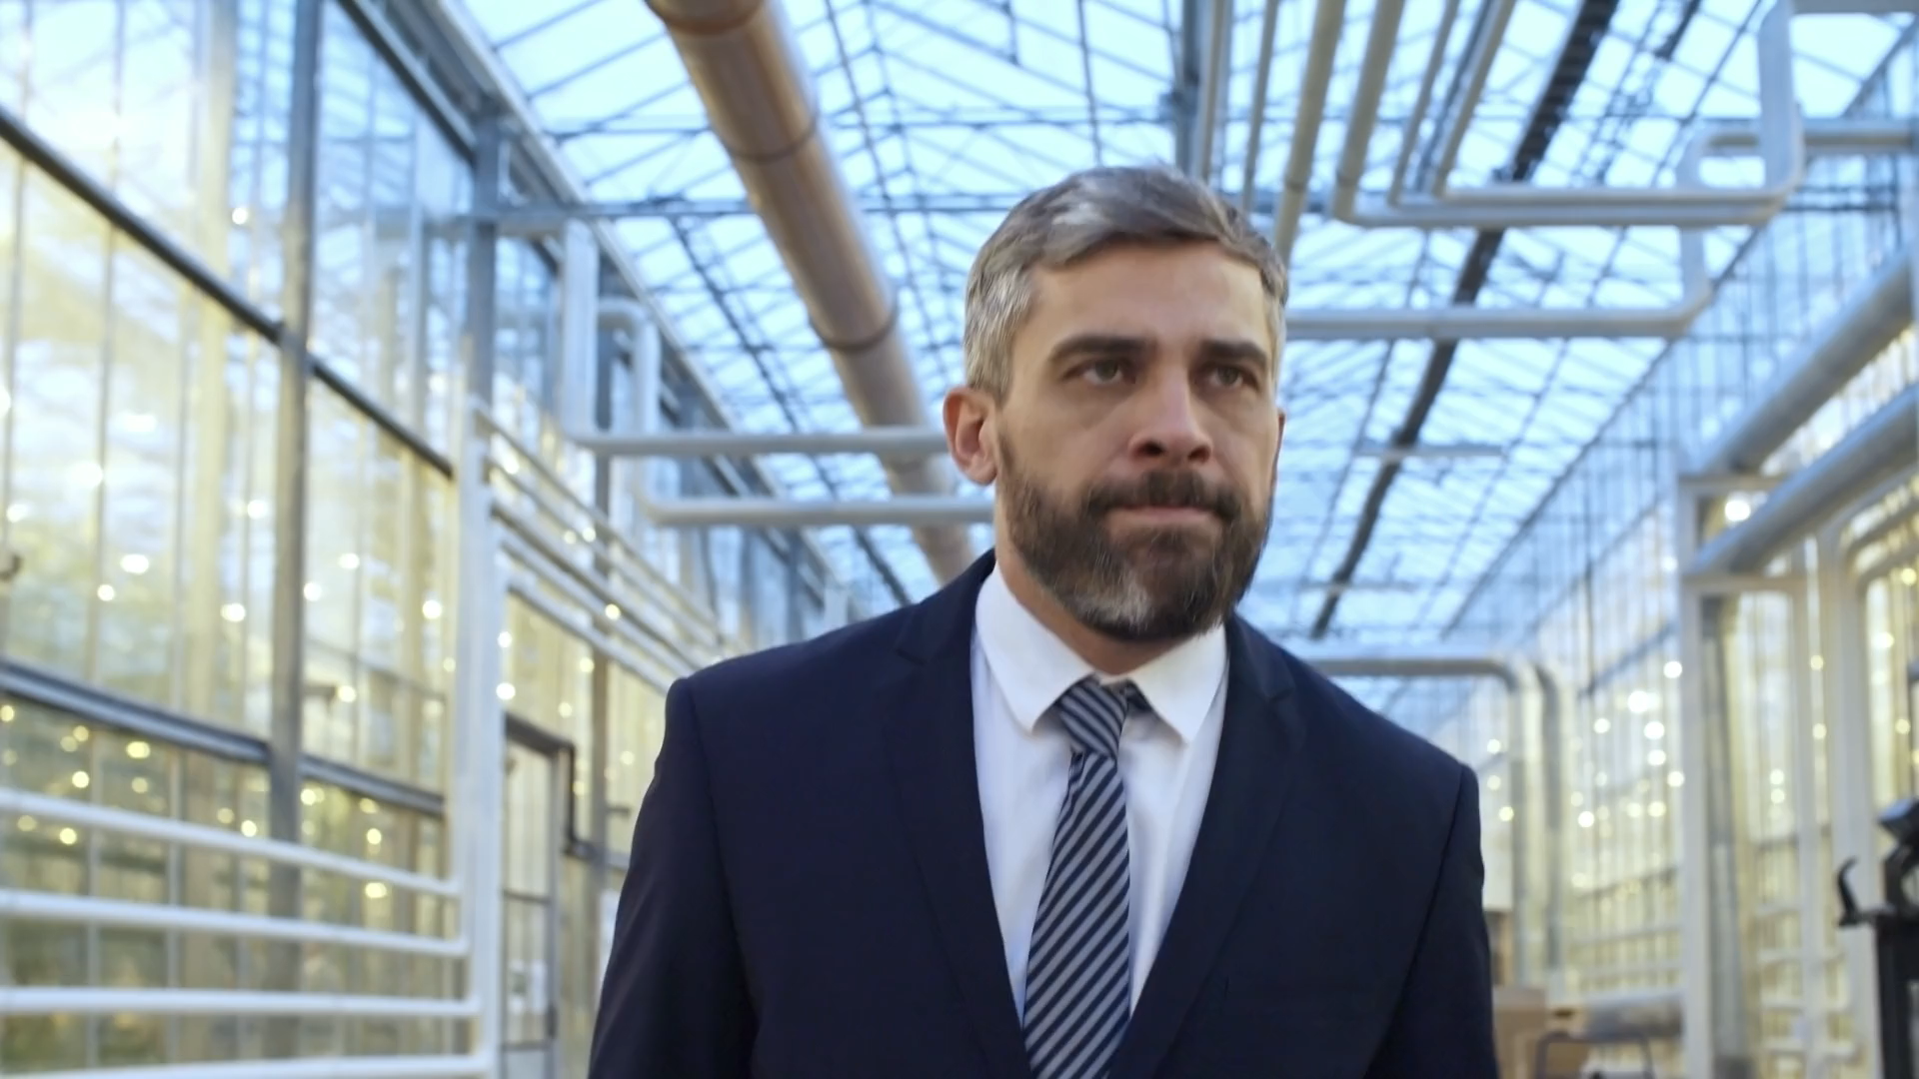
4.結果
ATTENTION
Notes:
https://pixabay.com/videos/man-walking-suit-business-office-199623/

Slide 7
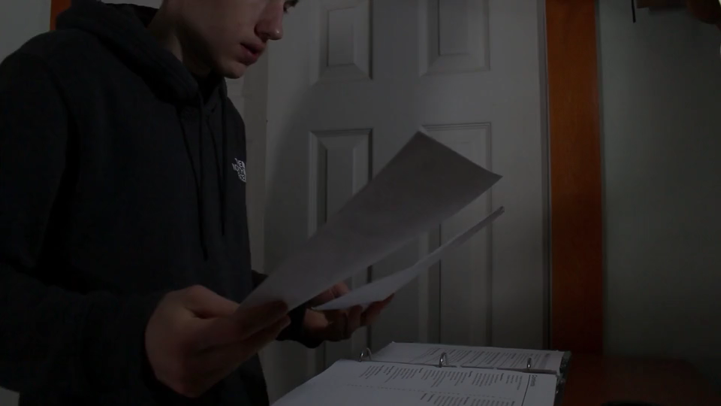
5.意外
ATTENTION
Notes:
https://pixabay.com/videos/anxiety-stress-depression-sad-107264/

Slide 8

6.轉彎
ATTENTION
Notes:
https://pixabay.com/videos/business-cooperation-communicate-46284/

Slide 9
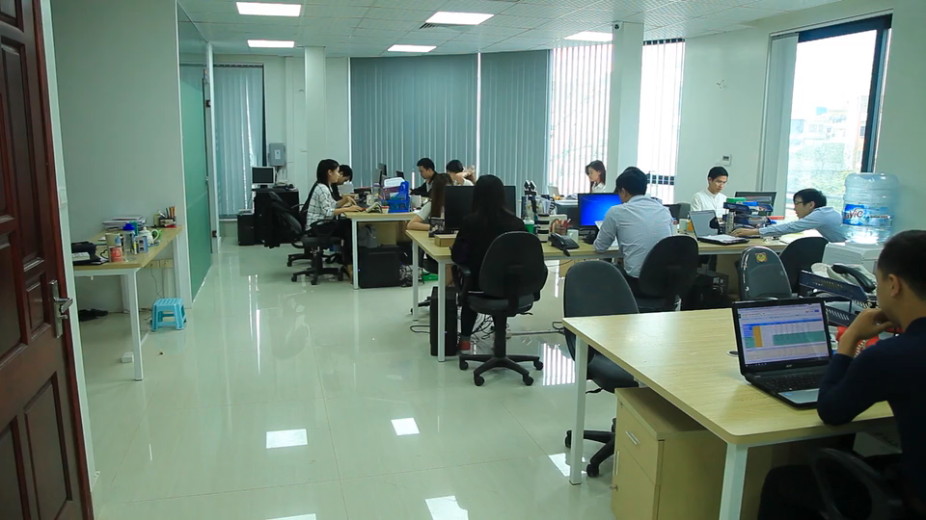
7.結局
ATTENTION
Notes:
https://pixabay.com/videos/girl-office-w-computer-work-27091/

Slide 10
非常事態
THE END

